Slide 1
Subprograms

Slide 2
General Subprogram Characteristics
Each subprogram has a single entry point.
The calling program unit is suspended during the execution of the called subprogram, which implies that there is only one subprogram in execution at any given time.
Control always returns to the caller when the subprogram execution terminates.

Slide 3
Parameter Profile
The parameter profile of a subprogram contains the number, order, and types of its formal parameters.
The protocol of a subprogram is its parameter profile plus, if it is a function, its return type.
In languages in which subprograms have types, those types are defined by the subprogram’s protocol.

Slide 4
Parameters
Formal parameters - parameters in the subprogram header.
Actual parameters - Subprogram call statements must include the name of the subprogram and a list of parameters to be bound to the formal parameters of the subprogram.
Positional parameters- The first actual parameter is bound to the first formal parameter and so forth.
Keyword parameters - can appear in any order in the actual parameter list.
sumer(length = my_length, list = my_array, sum = my_sum)

Slide 5
Procedure and Functions
Subprograms are collections of statements that define parameterized computations.
Functions return values and procedures do not.
Procedures can produce results in the calling program unit by two methods:
(1) If there are variables that are not formal parameters but are still visible in both the procedure and the calling program unit, the procedure can change them; and
(2) if the procedure has formal parameters that allow the transfer of data to the caller, those parameters can be changed

Slide 6
Function
If a function is a faithful model, it produces no side effects; that is, it modifies neither its parameters nor any variables defined outside the function.
Such a function returns a value—that is its only desired effect.
For example, the value of the expression f(x) is whatever value f produces when called with the parameter x. For a function that does not produce side effects, the returned value is its only effect.
The functions in most programming languages have side effects.

Slide 7
Design Issues
Are local variables statically or dynamically allocated?
Can subprogram definitions appear in other subprogram definitions?
What parameter-passing method or methods are used?
Are the types of the actual parameters checked against the types of the formal parameters?
If subprograms can be passed as parameters and subprograms can be nested, what is the referencing environment of a passed subprogram?
Are functional side effects allowed?
What types of values can be returned from functions?
How many values can be returned from functions?
Can subprograms be overloaded?
Can subprograms be generic?

Slide 8
Local Variables
Subprograms can define their own variables, thereby defining local referencing environments.
Either static or stack dynamic.
The main disadvantages of stack-dynamic local variables are the following:
First, there is the cost of the time required to allocate, initialize (when necessary), and deallocate such variables for each call to the subprogram.
Second, accesses to stack-dynamic local variables must be indirect, whereas accesses to static variables can be direct.
Finally, when all local variables are stack dynamic, subprograms cannot be history sensitive; that is, they cannot retain data values of local variables between calls. It is sometimes convenient to be able to write history- sensitive subprograms.
This indirectness is required because the place in the stack where a particular local variable will reside can be determined only during execution.
A common example of a need for a history- sensitive subprogram is one whose task is to generate pseudorandom numbers.

Slide 9
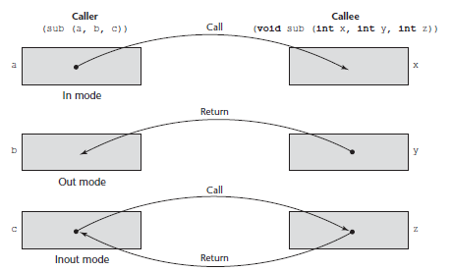
Parameters Passing
Formal parameters are characterized by one of three distinct semantics models:
(1) They can receive data from the corresponding actual parameter;
(2) they can transmit data to the actual parameter; or
(3) they can do both.
These models are called in mode, out mode, and inout mode, respectively

Slide 10
Parameters Passing
Pass-by-Value – Adv: fast Dis: Additional storage.
Pass-by-Result – same as above.
Pass-by-Value-Result (sometimes called pass-by-copy)
Pass-by-Reference – Adv: Duplicate space is not required Dis: Indirect addressing, Erroneous changes may be made.
Pass-by-name - complex

Slide 11
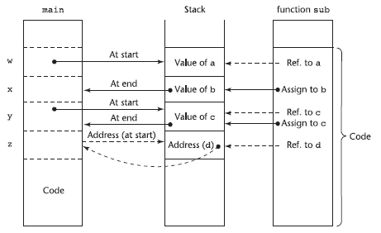
Implementing Parameter-Passing Methods

Slide 12
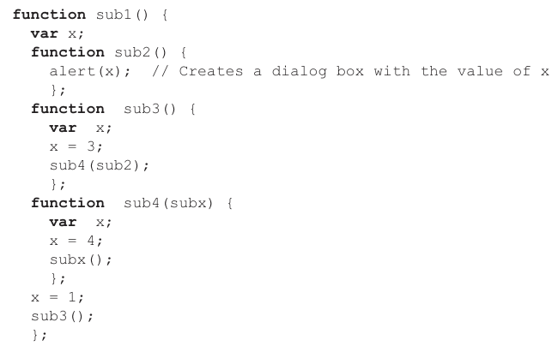
Parameters That Are Subprograms
The environment of the call statement that enacts the passed subprogram (shallow binding)
Sub2 from sub4 => 4
The environment of the definition of the passed subprogram (deep binding)
Sub2 from sub1 => 1
The environment of the call statement that passed the subprogram as an actual parameter (ad hoc binding)
Sub2 from sub3 => 3
Note: Consider the execution of sub2 when it is called in sub4.

Slide 13
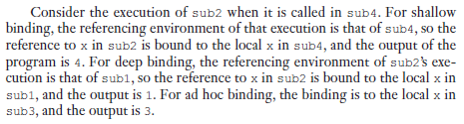
Parameters That Are Subprograms
function sub1() {
var x;
function sub2() {
alert(x); // Creates a dialog box with the value of x
};
function sub3() {
var x;
x = 3;
sub4(sub2);
};
function sub4(subx) {
var x;
x = 4;
subx();
};
x = 1;
sub3();
};

Slide 14
Calling Subprograms Indirectly
The call to the subprogram is made through a pointer or reference to the subprogram, which has been set during execution before the call is made.
The two most common applications of indirect subprogram calls are
for event handling in graphical user interfaces, which are now part of nearly all Web applications, as well as many non-Web applications, and
for callbacks, in which a subprogram is called and instructed to notify the caller when the called subprogram has completed its work.

Slide 15
Calling Subprograms Indirectly
int myfun2 (int, int); // A function declaration
int (*pfun2)(int, int) = myfun2; // Create a pointer and initialize it to point to myfun2
pfun2 = myfun2; // Assigning a function's address to a pointer

Slide 16
Closure
Normally when a function exits, all its local variables are blown away. However, if we return the inner function and assign it to a variable fnc so that it persists after outer has exited, all of the variables that were in scope when inner was defined also persist. The variable a has been closed over -- it is within a closure.
outer = function() {
var a = 1;
var inner = function()
{
console.log(a);
}
return inner; // this returns a function
}
var fnc = outer(); // execute outer to get inner
fnc();

Slide 17
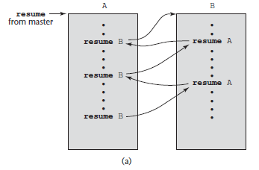
Coroutines
A coroutine is a special kind of subprogram.
Rather than the master-slave relationship between a caller and a called subprogram that exists with conventional subprograms, caller and called coroutines are more equitable.
In fact, the coroutine control mechanism is often called the symmetric unit control model.
Coroutines can have multiple entry points, which are controlled by the coroutines themselves.
# A Python program to generate numbers in a
# range using yield
def rangeN(a, b):
i = a
while (i < b):
yield i
i += 1 # Next execution resumes
# from this point
for i in rangeN(1, 5):
print(i)

Slide 18
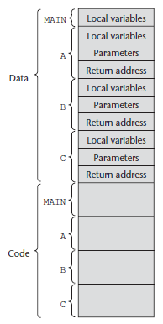
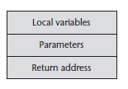
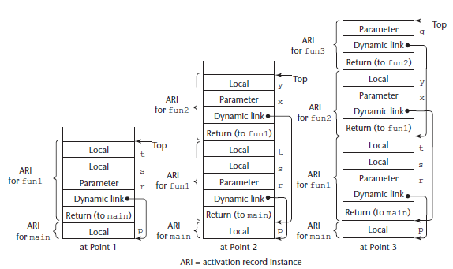
Activation Record

Slide 19
Multidimensional Arrays as Parameters
void fun(int matrix[][10]) { . . . }
void main() {
int mat[5][10];
. . .
fun(mat);
. . .
}
For row as well as column
void fun(float *mat_ptr, int num_rows, int num_cols)

Slide 20
Returned Values
a, b, c = fun()

Slide 21
Abstract Data Type
create(stack) Creates and possibly initializes a stack object
destroy(stack) Deallocates the storage for the stack
empty(stack) A predicate (or Boolean) function that returns true if the specified stack is empty and false otherwise
push(stack, element) Pushes the specified element on the specified stack
pop(stack) Removes the top element from the specified stack
top(stack) Returns a copy of the top element from the specified stack

Slide 22
Union Types
Store one value at a time that is recent but how C manages to get more.
Union Punning

Slide 23
Row major and column major order

Slide 24
Pointer and Reference
Reference and Pointer
Dangling Pointer – tombstones
The pointer – sometimes called the handle – points only at tombstones and never to its actual target.
When the data is deallocated, the tombstone is set to a null (or, more generally, to a value that is illegal for a pointer in the given runtime environment), indicating that the variable no longer exists

